Slide 1

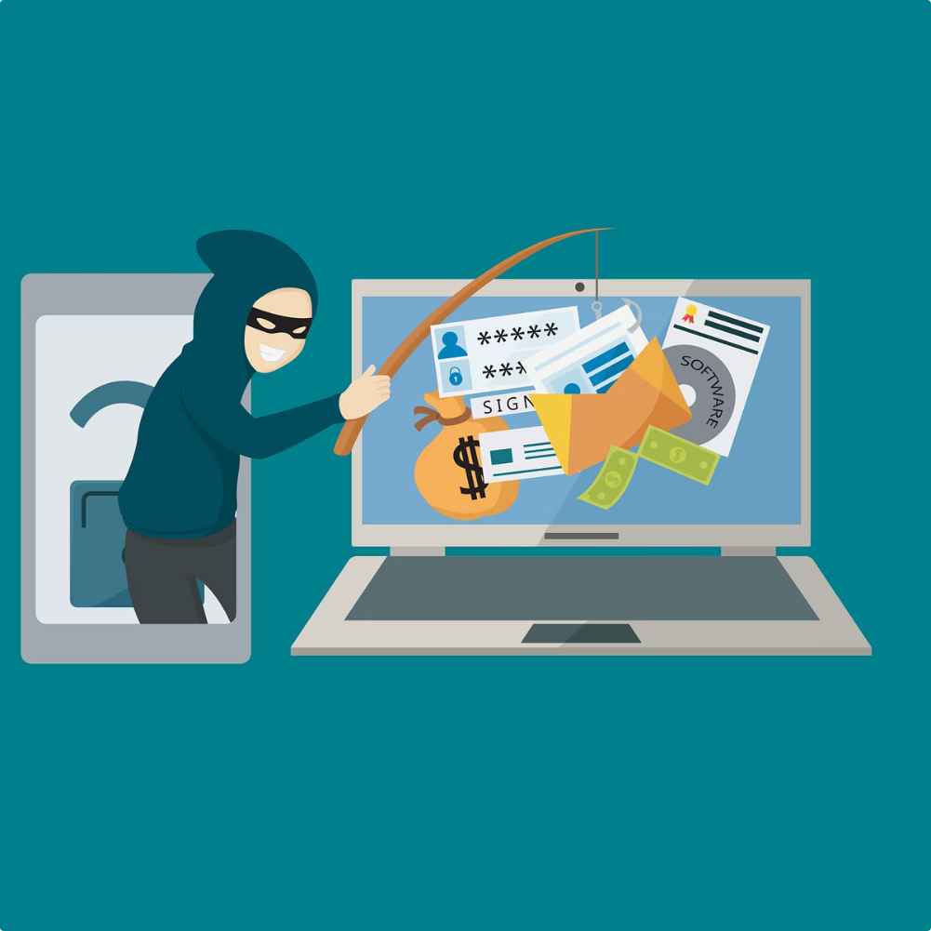

Phishing Awareness Training
Understanding, Identifying & Preventing Phishing Attacks
This training session is designed to equip employees with the knowledge to recognize phishing attempts, understand different types of attacks, and implement effective prevention techniques. Phishing remains one of the most prevalent cybersecurity threats, exploiting human behavior to access sensitive information. With increasing sophistication in attacks, awareness and proactive measures are essential to protect both personal and organizational data.
by Ayesha Yousufi

Slide 2
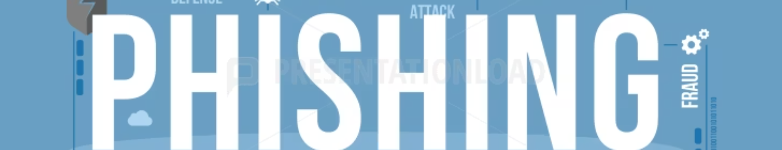
What is Phishing?
Fraudulent Attempts
Disguised Communication
Common Targets
Phishing involves tricking individuals into revealing sensitive data such as passwords, credit card numbers, or confidential business information by masquerading as trusted sources.
These attempts often look like legitimate emails, websites, or messages, which increases their chance of deceiving recipients.
The typical targets include login credentials for email or company portals, financial account details, and other personal identifiers.

Slide 3

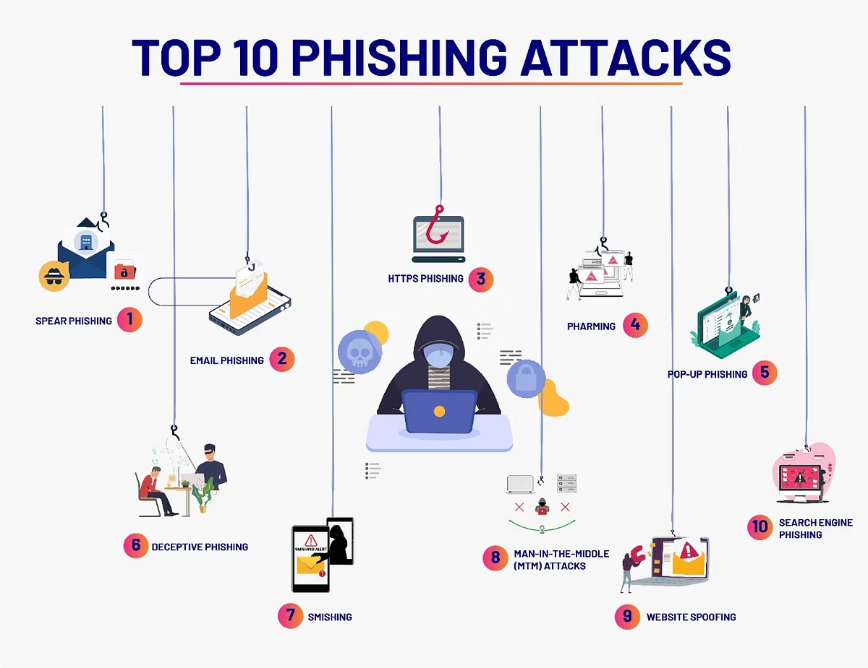
Types of Phishing Attacks
Deceptive Phishing
Mass emails or fake websites are sent to steal sensitive information by impersonating trusted entities.
Spear Phishing
Highly targeted attacks aimed at specific individuals using gathered personal information to increase credibility.
Whaling
Focused attacks against high-level executives and decision-makers with potentially devastating consequences.
Pharming
Users are redirected to fraudulent websites through DNS poisoning or other techniques, often without their knowledge.

Slide 4
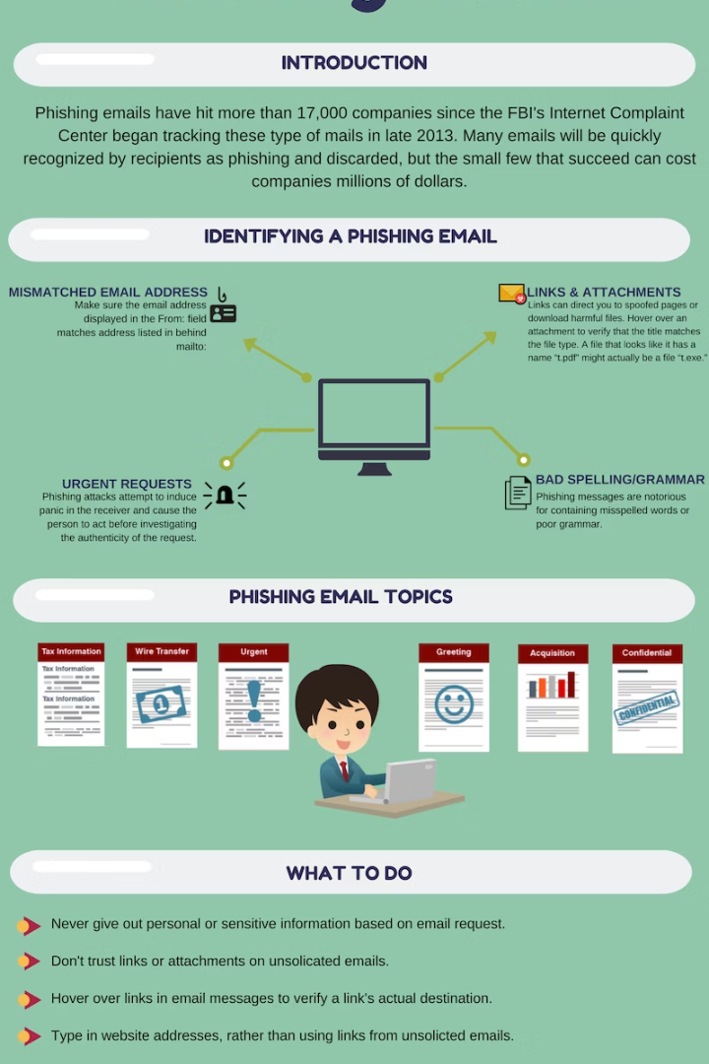
Recognizing Phishing Emails & Websites
Check URLs Carefully
Watch for Urgency
Mismatched or misspelled web addresses are a common sign of fraudulent websites.
Emails pressuring immediate action or threatening consequences should trigger suspicion.
Verify Senders
Confirm the sender’s email address and watch for improper use of logos and branding.

Slide 5

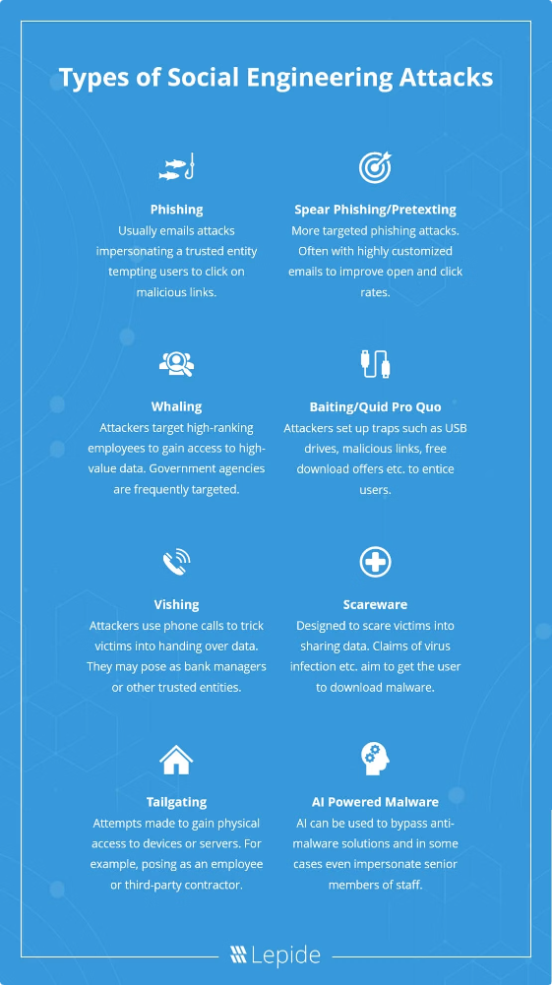
Social Engineering Tactics
Baiting
Pretexting
Tailgating
Offering something attractive such as free software or prizes to lure victims into compromised actions.
Attackers create fabricated stories to gain trust and extract confidential information.
Physically following authorized personnel into secure areas to bypass access controls.

Slide 6
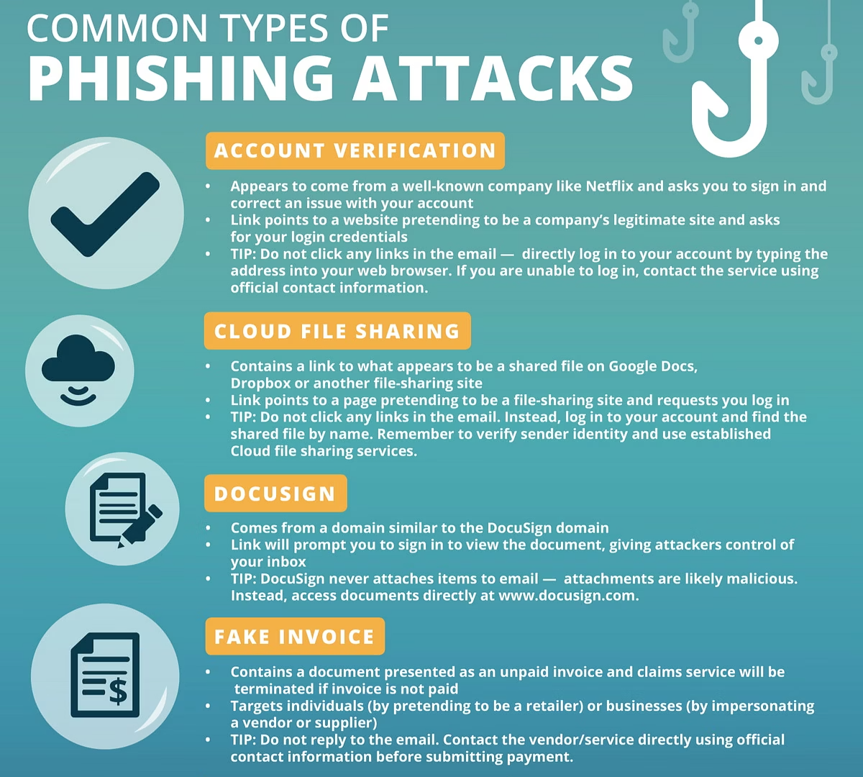



Best Practices to Avoid Phishing
Avoid Suspicious Links
Do not click on unknown links or download attachments without verifying authenticity.
Use Multi-Factor Authentication
Add an extra security layer to accounts to minimize unauthorized access risks.
Report Attempts
Immediately notify IT or security teams about suspected phishing encounters for rapid response.

Slide 7



Real-World Examples
Google & Facebook Scam
A fraudulent invoicing scheme resulting in losses over $100 million to these tech giants.
2016 DNC Spear Phishing
Political attack targeting Democratic National Committee to gain confidential access and influence elections.
Netflix & PayPal Campaigns
Mass phishing emails impersonating popular services aimed at stealing user credentials.
2
1
3

Slide 8

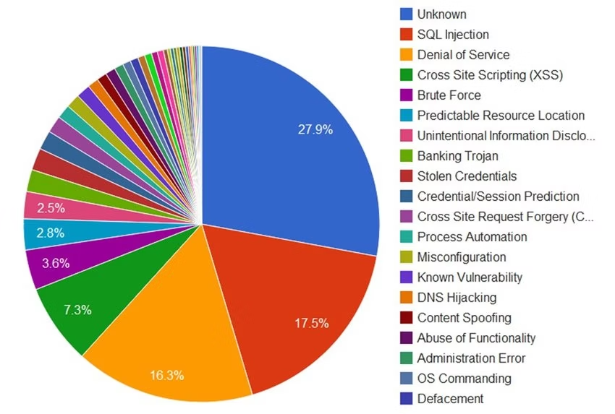
Phishing Attack Trends & Statistics
Phishing attacks have steadily increased in both frequency and sophistication over recent years. Data shows a rise driven largely by spear phishing and whaling targeted at high-value individuals and organizations. Awareness campaigns combined with technology solutions are critical to mitigate these evolving threats. Continuing education and vigilance remain vital to maintaining security defenses against these pervasive attacks.

Slide 9

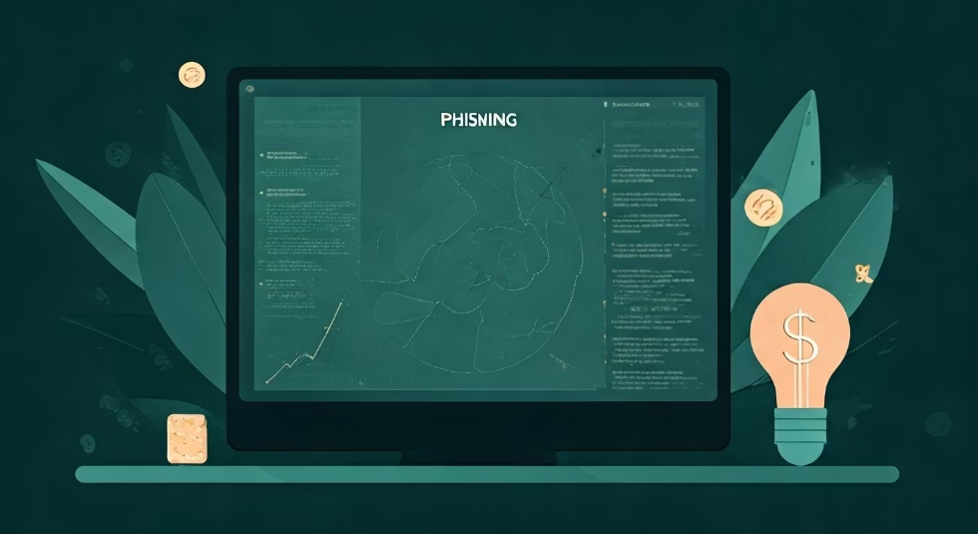
QUIZ TIME !

Slide 10
Quiz Q1: Which of the following is a sign of a phishing email?
A. The sender's email matches your contacts B. The message has perfect grammar and no links C. It contains a sense of urgency and suspicious links D. It was sent by your teacher about class timing
🧠 Test Your Knowledge: Phishing emails often wear a mask of urgency and familiarity. Recognizing their signs—before you click—is your first shield in cybersecurity.

Slide 11

CORRECT ANSWER
MOVE TO NEXT QUESTION

Slide 12
Quiz Q2: What is “Spear Phishing”?
A. A phishing attack sent to thousands of random users B. A fake website that steals login info C. A targeted phishing attack aimed at a specific individual D. A method of stealing credit cards physically
🧠 Test Your Knowledge: Not all phishing attacks are random. Some are designed specifically for you. Understanding targeted tactics like spear phishing helps you stay one step ahead.

Slide 13
CORRECT ANSWER
MOVE TO NEXT QUESTION

Slide 14
Quiz Q3: You receive an email from “admin@amaz0n.com” asking to confirm your purchase. What should you do first?
A. Click the link and check your order B. Check the sender’s email domain and contact Amazon directly C. Ignore it, phishing doesn’t affect real users D. Forward it to your friends so they’re aware
🧠 Test Your Knowledge: Cyber attackers count on you to panic or act quickly. Learning to inspect email domains and stay calm under pressure is key to avoiding phishing traps.

Slide 15
CORRECT ANSWER
MOVE TO NEXT QUESTION

Slide 16
Quiz Q4: Which type of phishing involves attackers posing as a CEO or manager to trick employees?
A. Vishing B. Whaling C. Smishing D. Pharming
🧠 Test Your Knowledge: Even CEOs can be targets—and weapons. Whaling attacks use their authority to manipulate staff. Knowing how to identify executive impersonation can save your team from disaster.

Slide 17
CORRECT ANSWER
MOVE TO NEXT QUESTION

Slide 18
Quiz Q5: What is the most important way to protect yourself from phishing?
A. Using public Wi-Fi carefully B. Always trusting links from friends C. Avoiding all email communication D. Verifying links and sender identity before clicking
🧠 Test Your Knowledge: Cybersecurity begins with behavior. Verifying every link and sender builds habits that outsmart even the cleverest phishing tactics. Stay sharp. Stay safe.

Slide 19
CORRECT ANSWER
MOVE AHEAD

Slide 20

WRONG ANSWER
GO BACK

Slide 21
Thank You for Being Cyber Smart
"Every click is a choice. You chose to be informed—now you’re dangerous to attackers
Trained by: Ayesha Yousufi
Email: ayeshayousufi17@gmail.com
GitHub Profile: https://github.com/ayesha-yt

